Slide 1
Operating System Security
Data Recovery using Hiren’s BootCD PE | Recuva

Slide 2

Group 2 Members
STUDENT NAME | STUDENT NUMBER
James Soko | 20231392
Astone Mwamba | 20231951
Ben Zulu | 20231886
Alinet Hangoba | 20231685
Namusonkwe Naomi | 20230443
Albert Mulenga | 20230427
Albertina Mwewa | 20231875
Alinuswe Simbeye | 20231271
Cindy Ngadalo | 22175202
Boyd Phiri Jr. | 20231939
Obed Mwape | 20231799
Carestone Mupaile | 20231899
Nelson Kapinga | 20231839
Gabriel Hichintu | 20231919
Rabby Chongo | 20231350
Violet Kikumbaila | 20231791

Slide 3
QUESTION
Recover a music file deleted from any memory stick using Hiren’s BootCD PE

Slide 4
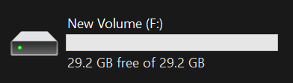
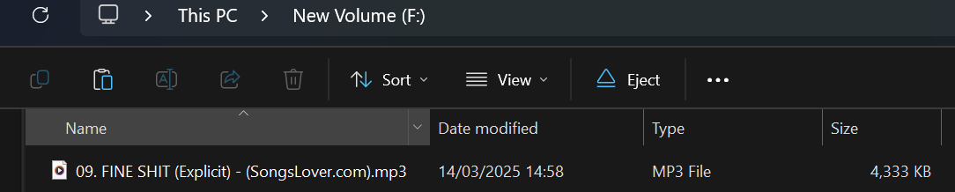
Deleting a Music File
Insert a USB Drive and format it.
Copy a music file to the USB Drive.
Delete the music file from the USB Drive.

Slide 5
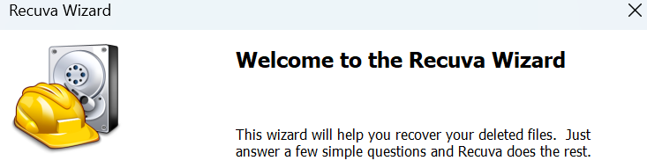


Configuring Recuva
Open Recuva.
Select our File Type as Music.
Select File Location: In a Specific Location.

Slide 6

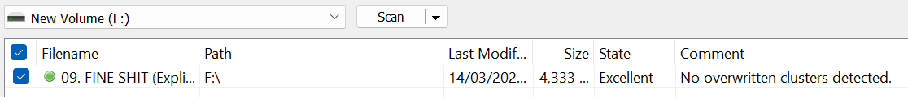

Recovering a Deleted Music File
Start the Scan and go to Advanced Mode.
Select the music file you want to recover.
Recover the music file and save it on another storage device.

Slide 7
Pros
Free Version – Recuva offers unlimited data recovery for free, making it a cost-effective solution.
User-Friendly Interface – The wizard mode simplifies the recovery process for beginners.
Fast Scanning – Recuva's scanning speed is impressive, particularly for quick scans.
Secure Delete – The ability to securely delete files is a valuable feature.
Lightweight – The software has a small installation size and is not resource-intensive.

Slide 8
Cons
Outdated Interface – The user interface feels outdated and lacks modern design elements.
Limited Recovery Performance – Recuva struggles with recovering files from formatted drives and maintaining original folder structures.
Lack of Advanced Features – Missing features like automatic scan resumption and support for mobile devices and RAID configurations.
Inaccurate Recovery Chances – The software's prediction of recovery chances is often inaccurate.
No Major Updates – Recuva has not received significant updates since 2016, raising concerns about its long-term viability.

Slide 9
Hope you enjoy listening to your precious music
End of Presentation

